Slide 1



TravelByStudents
View in Power BI
Last data refresh:
8/28/2023 1:14:10 PM UTC
Downloaded at:
8/28/2023 1:18:46 PM UTC

Slide 2
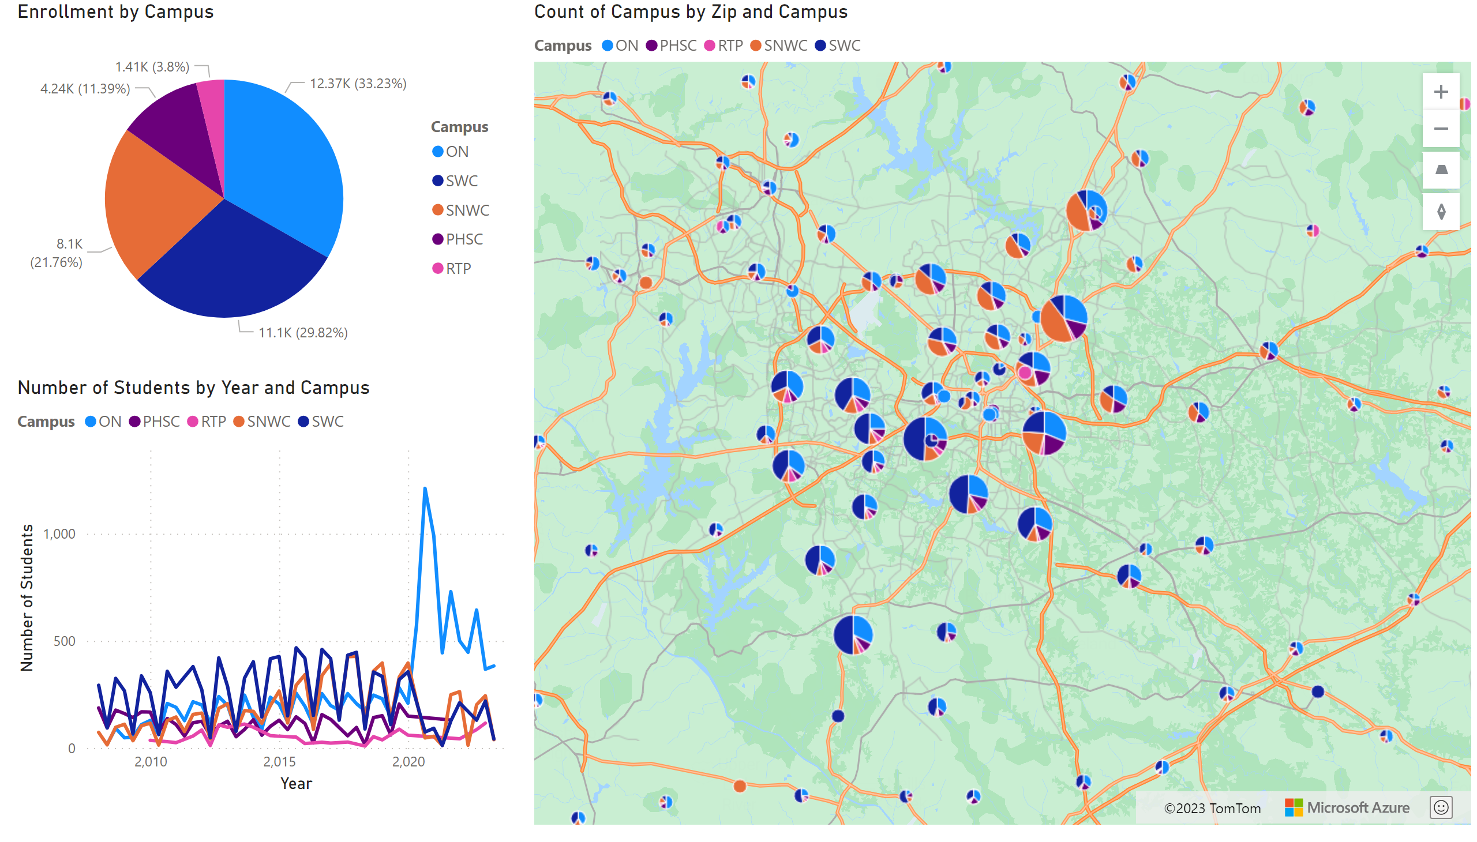
Snapshot by Campus
Notes:
pieChart
No alt text provided
lineChart
No alt text provided
azureMap
No alt text provided

Slide 3
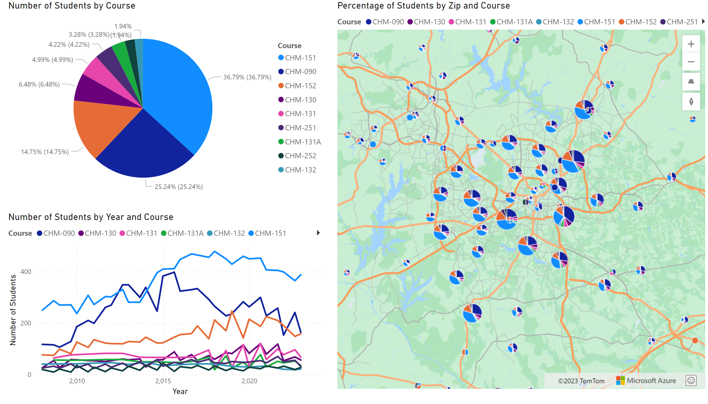
Snapshot By Course During Regular Semester
Notes:
pieChart
No alt text provided
lineChart
No alt text provided
azureMap
No alt text provided

Slide 4
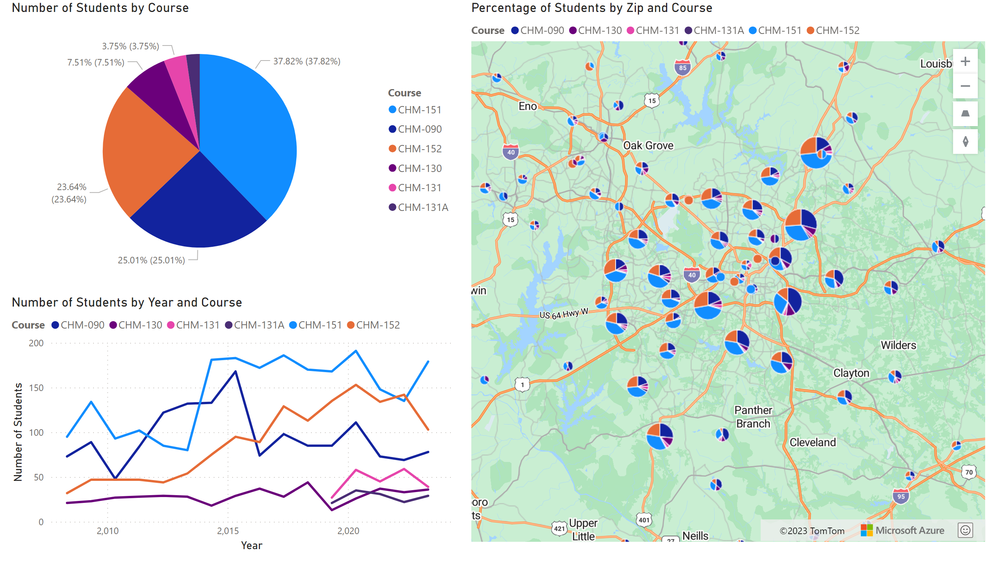
Snapshot By Course During Summer Semester
Notes:
pieChart
No alt text provided
lineChart
No alt text provided
azureMap
No alt text provided

Slide 5
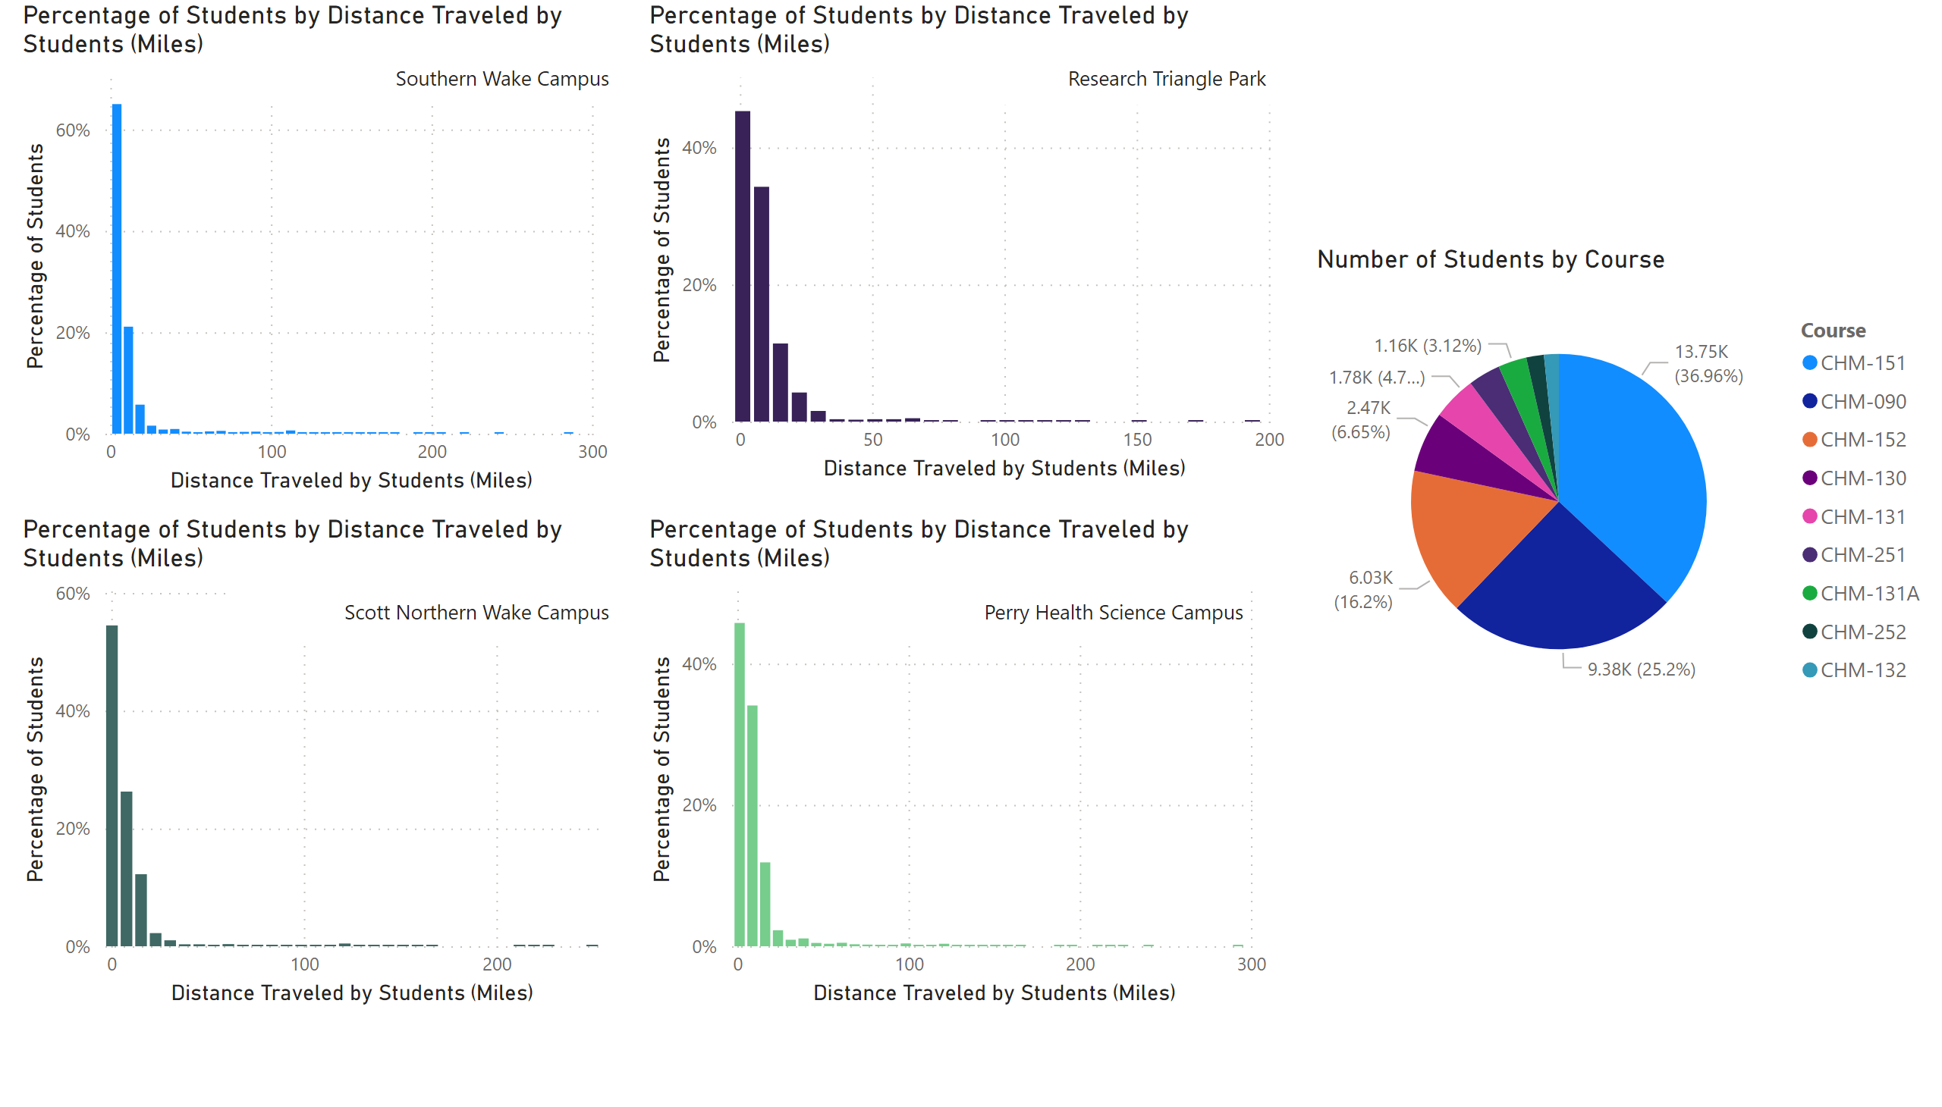
Distances Traveled By Course
Notes:
clusteredColumnChart
No alt text provided
clusteredColumnChart
No alt text provided
clusteredColumnChart
No alt text provided
clusteredColumnChart
No alt text provided
textbox
No alt text provided
textbox
No alt text provided
textbox
No alt text provided
textbox
No alt text provided
pieChart
No alt text provided

Slide 6
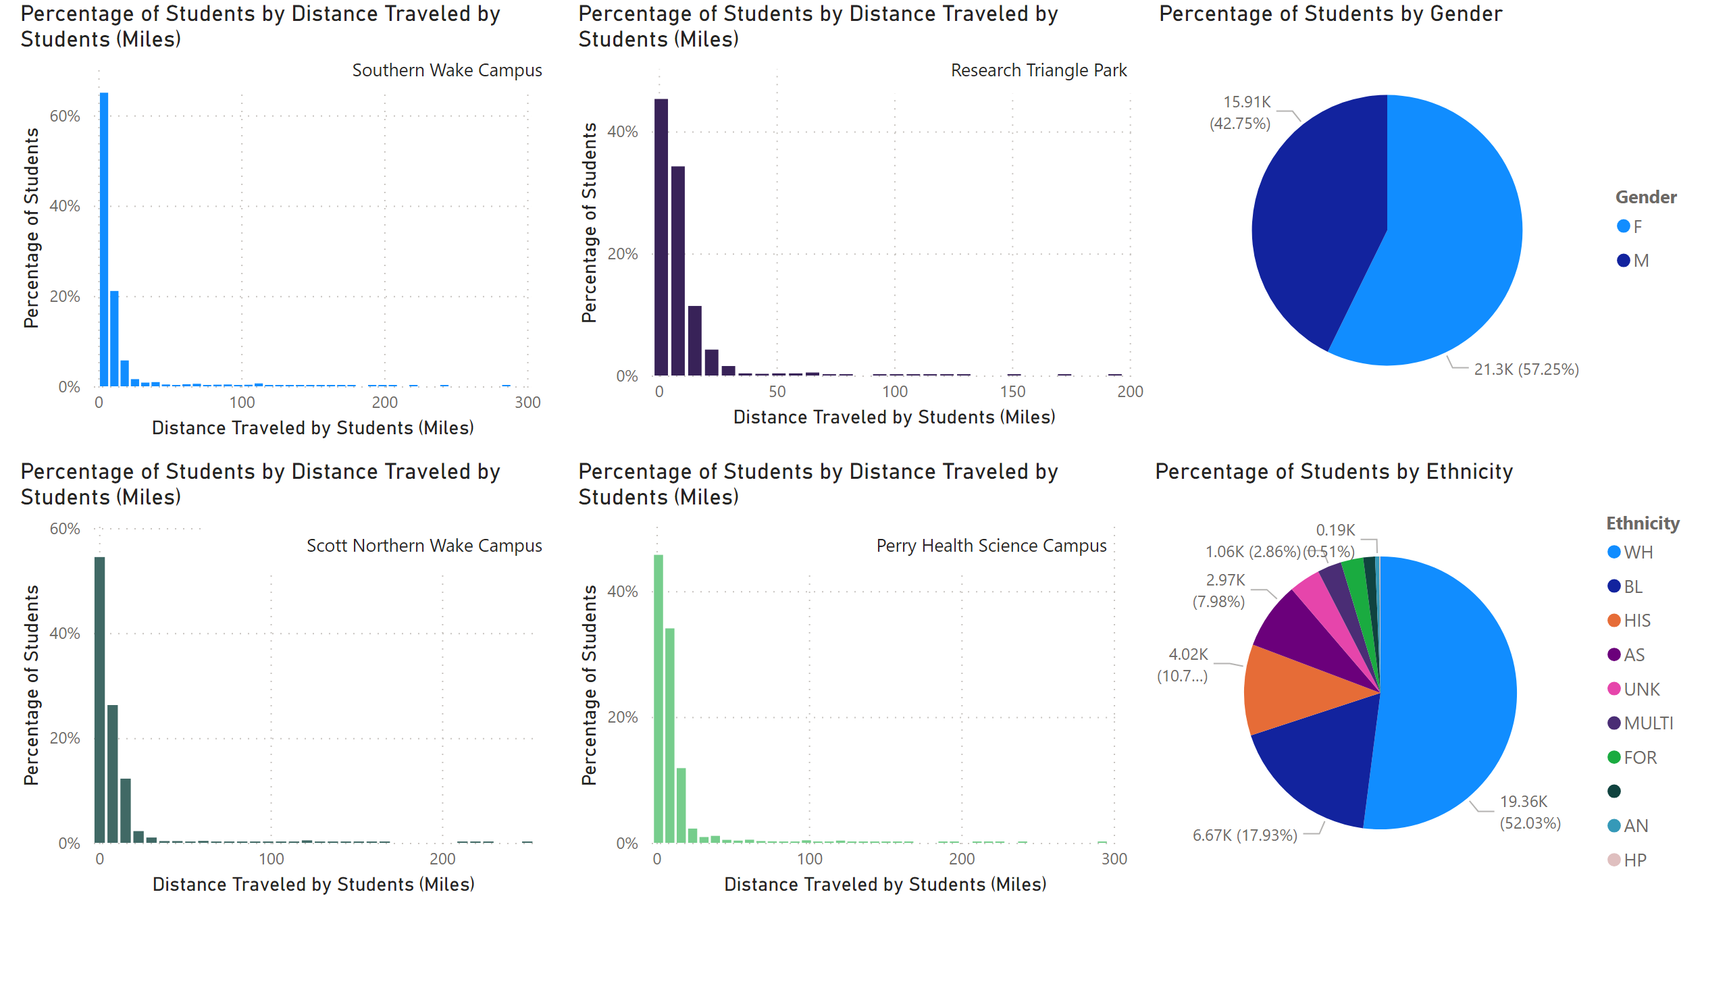
Distances Traveled By Demographic
Notes:
clusteredColumnChart
No alt text provided
clusteredColumnChart
No alt text provided
clusteredColumnChart
No alt text provided
clusteredColumnChart
No alt text provided
textbox
No alt text provided
textbox
No alt text provided
textbox
No alt text provided
textbox
No alt text provided
pieChart
No alt text provided
pieChart
No alt text provided

Slide 7
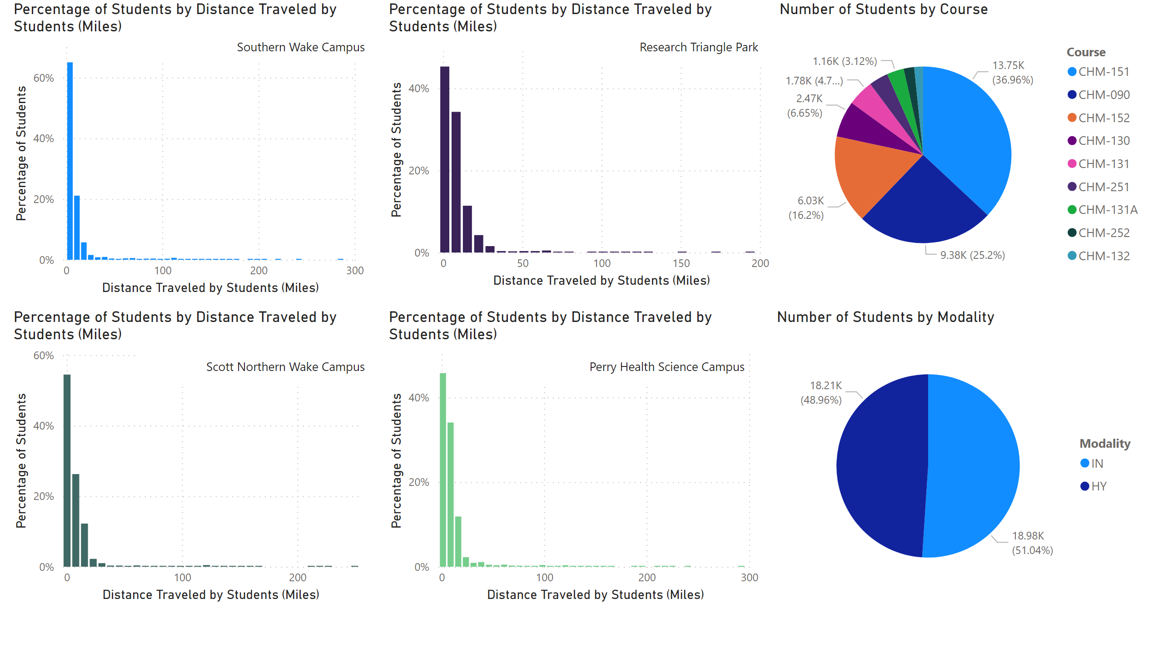
Distances Traveled By Modality
Notes:
clusteredColumnChart
No alt text provided
clusteredColumnChart
No alt text provided
clusteredColumnChart
No alt text provided
clusteredColumnChart
No alt text provided
textbox
No alt text provided
textbox
No alt text provided
textbox
No alt text provided
textbox
No alt text provided
pieChart
No alt text provided
pieChart
No alt text provided

Slide 8
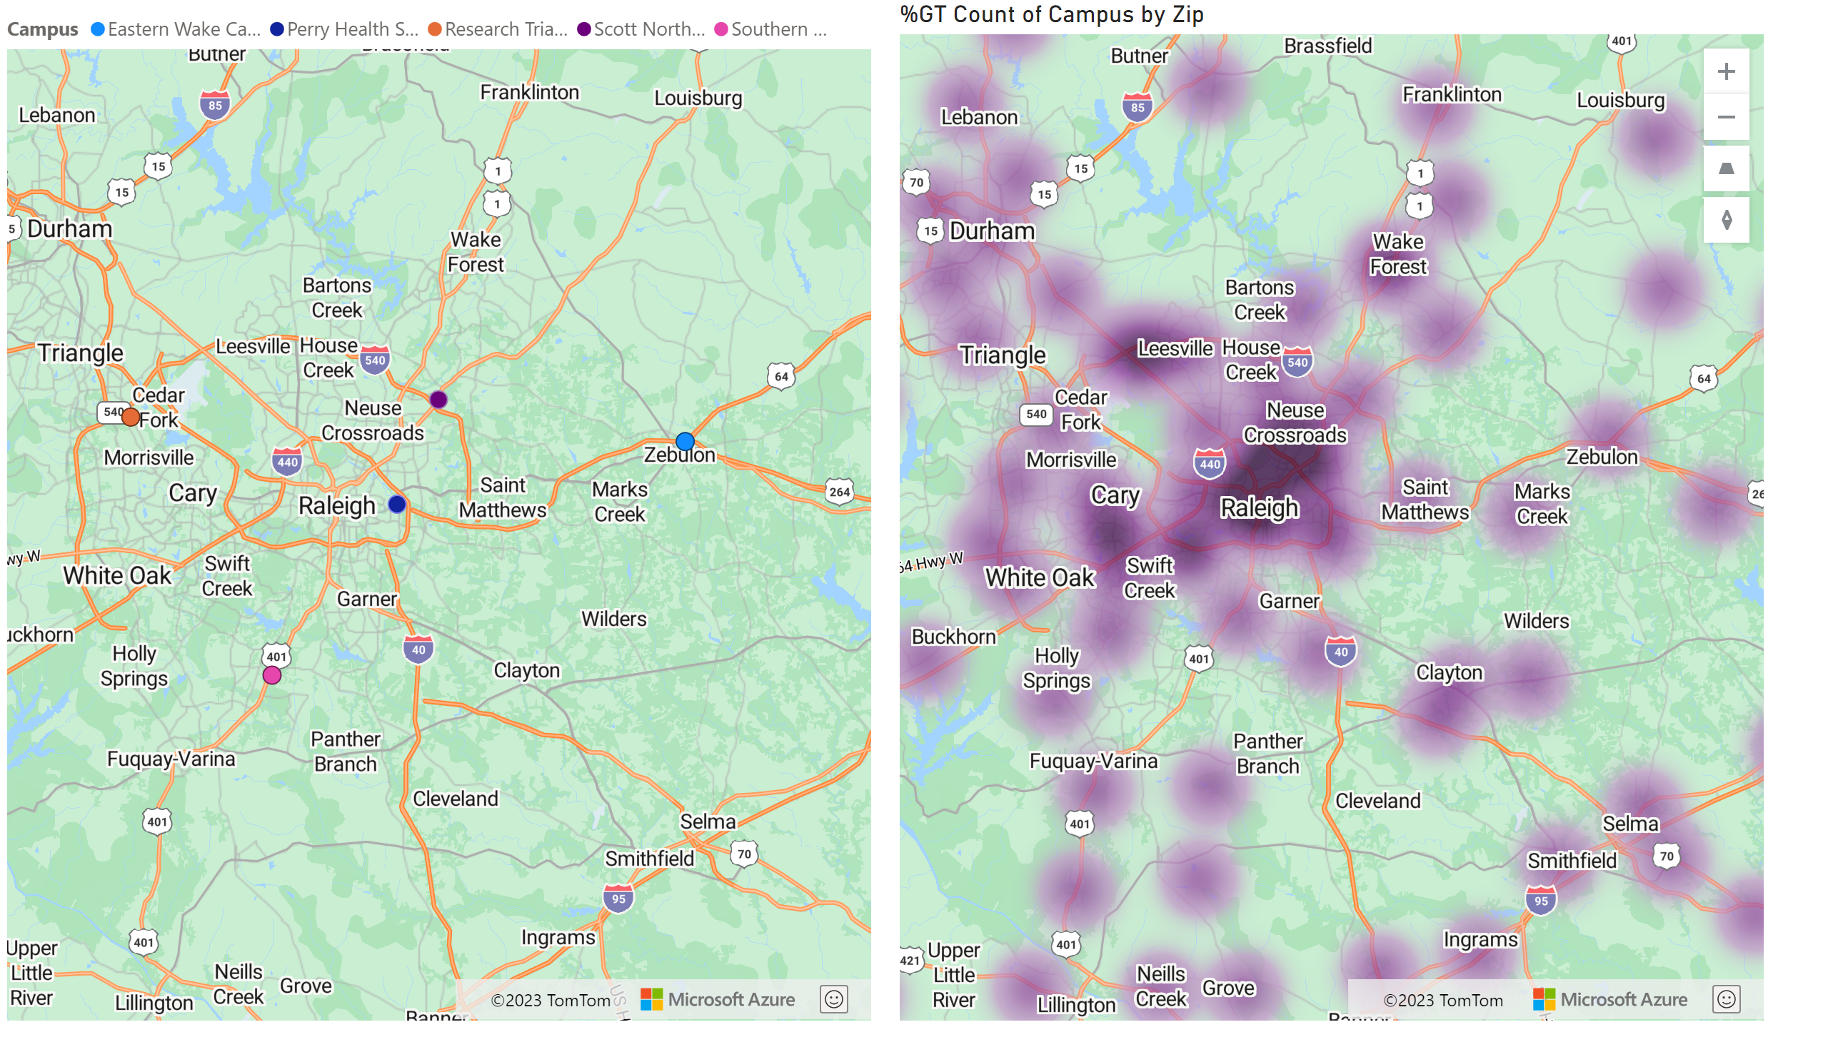
Campuses vs Students Served
Notes:
azureMap
No alt text provided
azureMap
No alt text provided

Slide 9
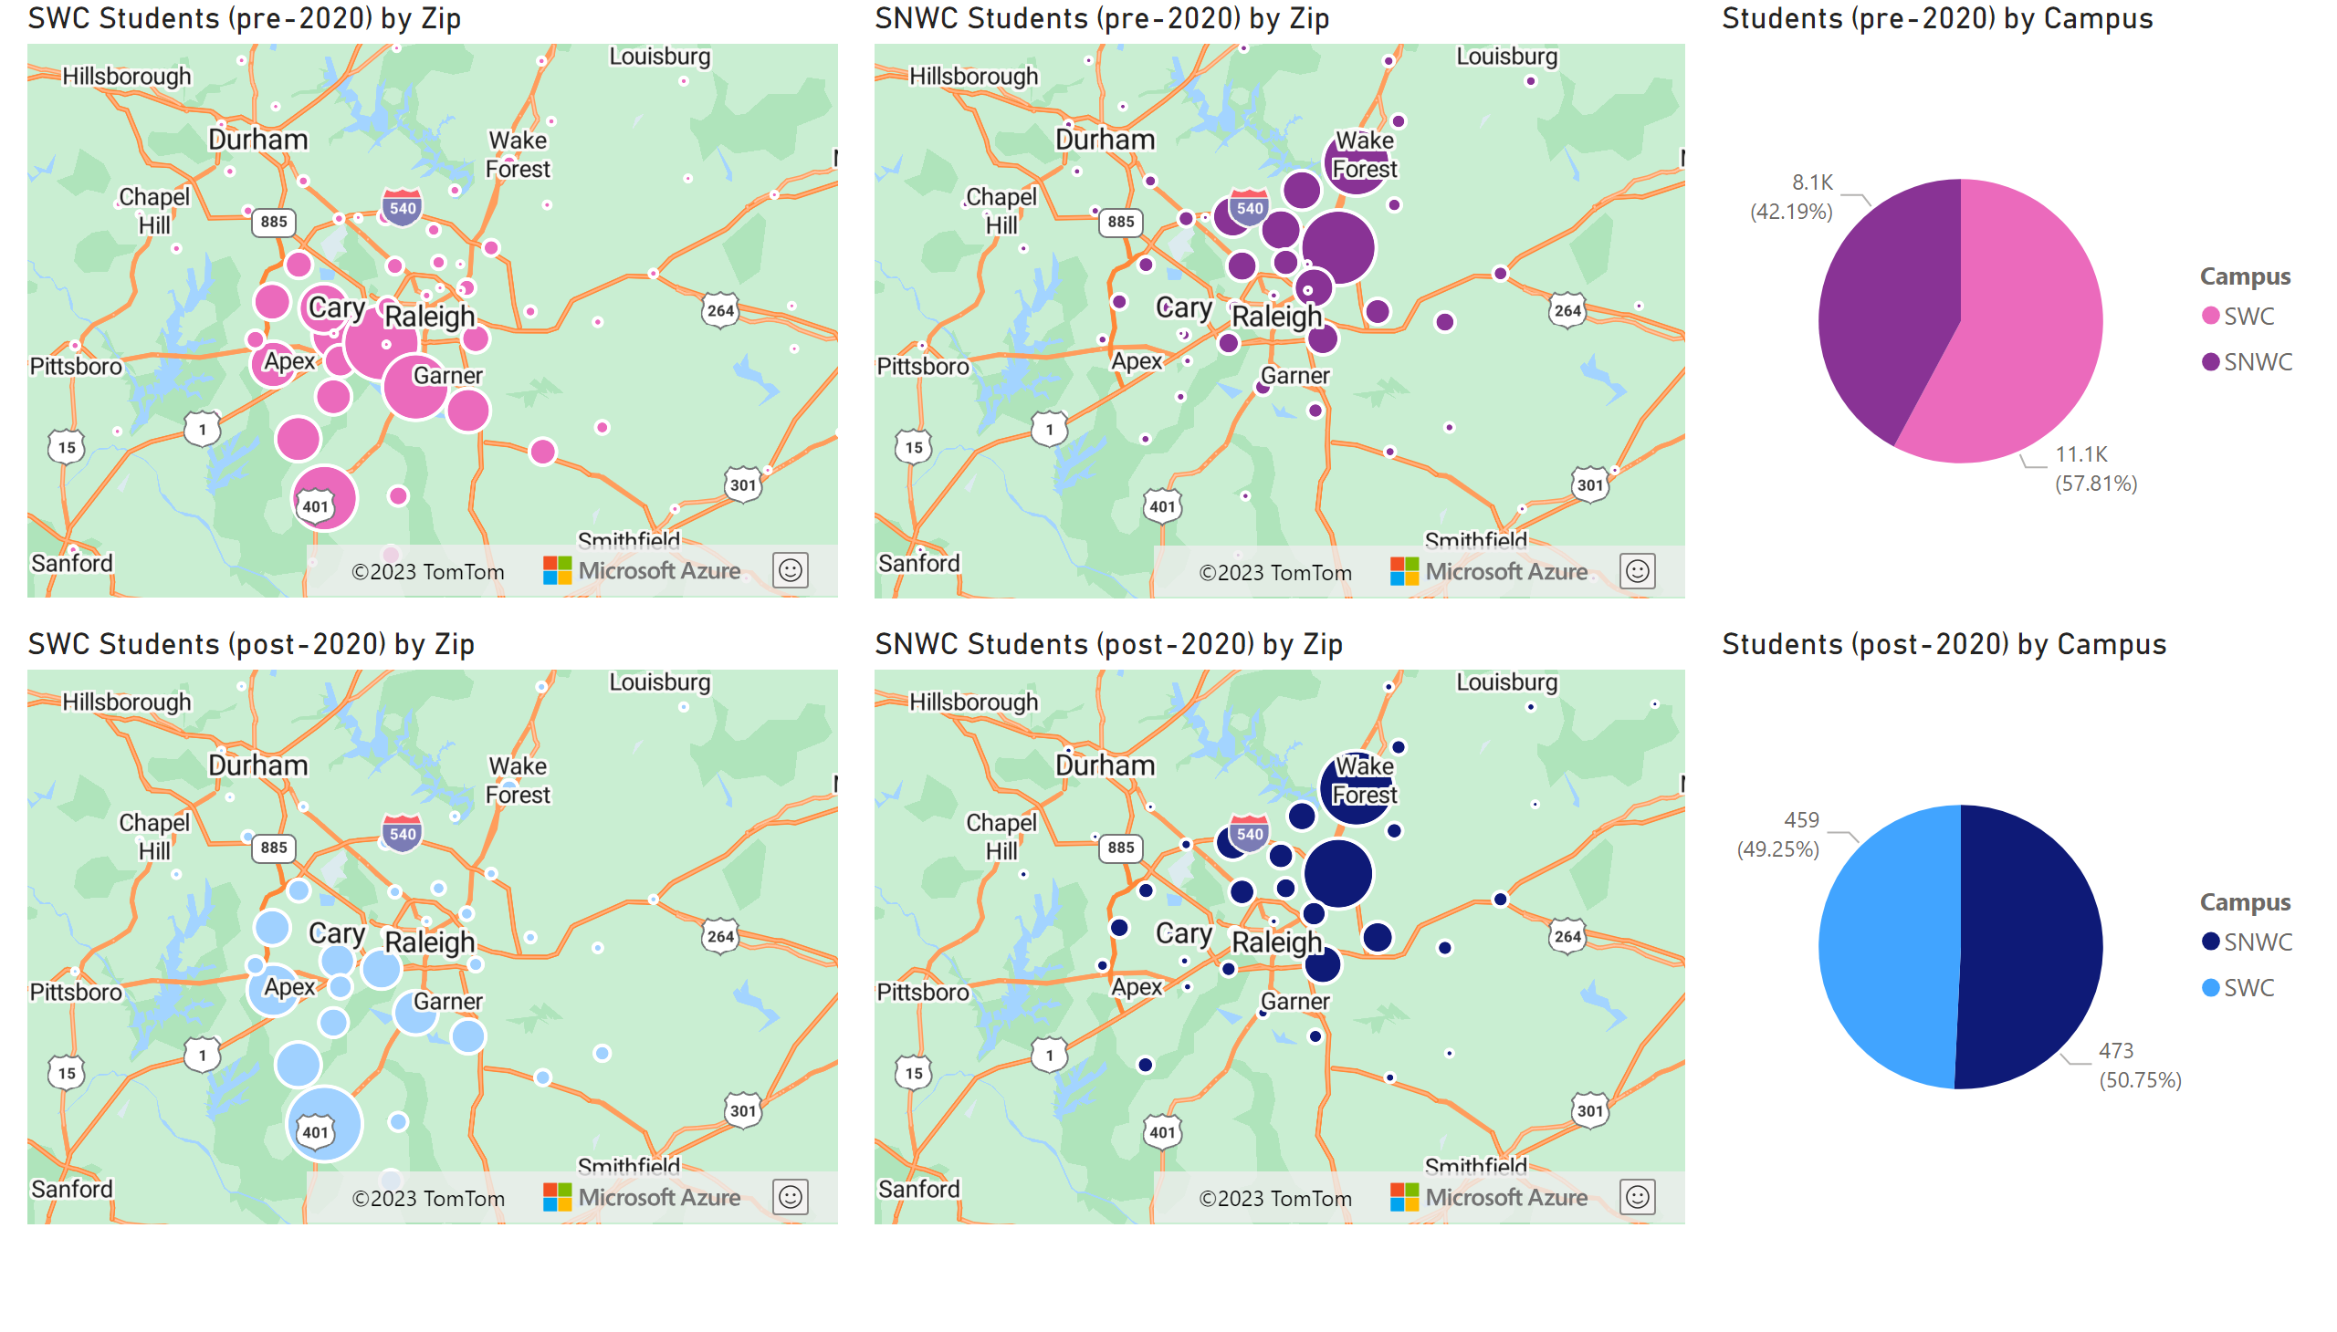
Case Study: CHM151
Notes:
azureMap
No alt text provided
azureMap
No alt text provided
azureMap
No alt text provided
azureMap
No alt text provided
pieChart
No alt text provided
pieChart
No alt text provided

Slide 10
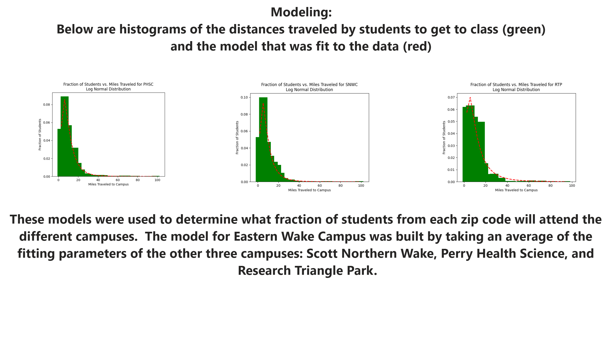
Modeling Results
Notes:
image
No alt text provided
image
No alt text provided
image
No alt text provided
textbox
No alt text provided
textbox
No alt text provided

Slide 11
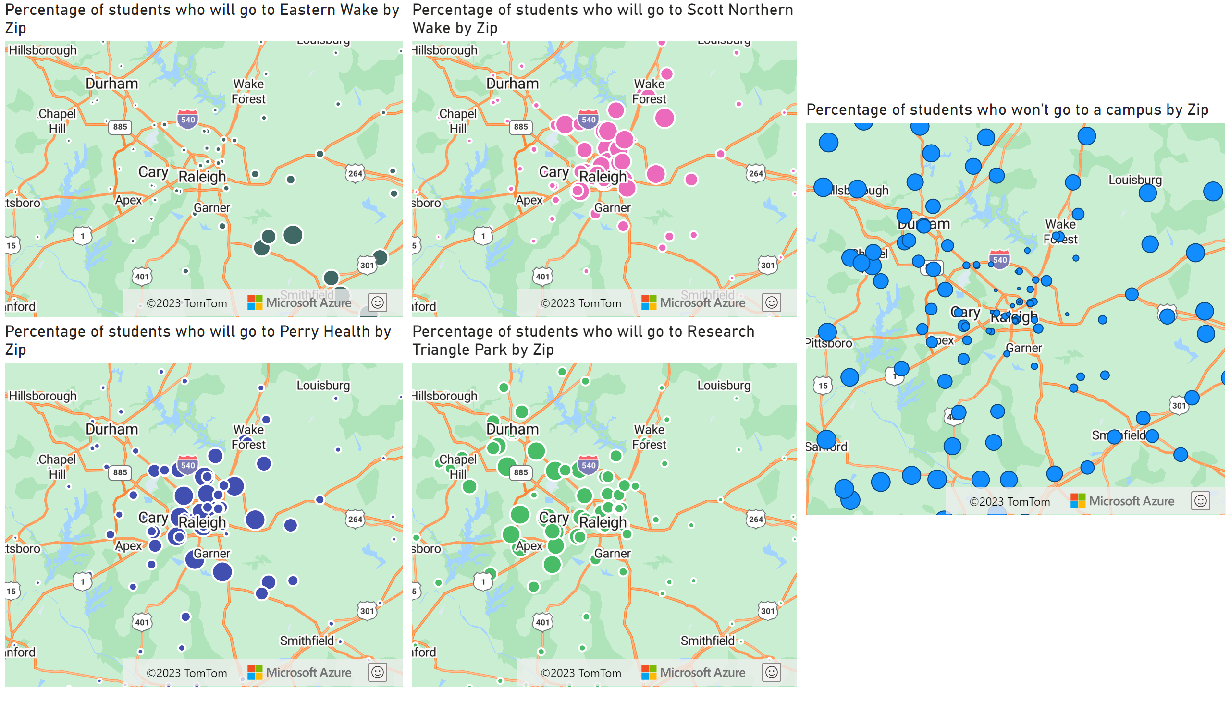
Expected Redistribution - Overall Campus
Notes:
azureMap
No alt text provided
azureMap
No alt text provided
azureMap
No alt text provided
azureMap
No alt text provided
azureMap
No alt text provided

Slide 12
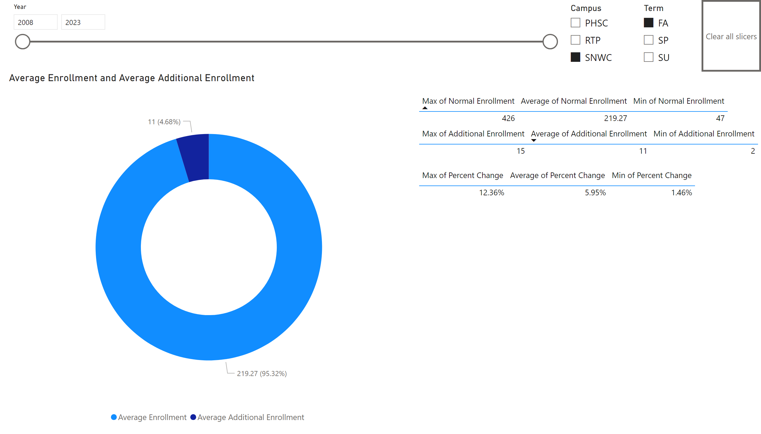
Campus Impact on Existing Campuses
Notes:
slicer
No alt text provided
slicer
No alt text provided
actionButton
No alt text provided
donutChart
No alt text provided
tableEx
No alt text provided
tableEx
No alt text provided
tableEx
No alt text provided
slicer
No alt text provided

Slide 13
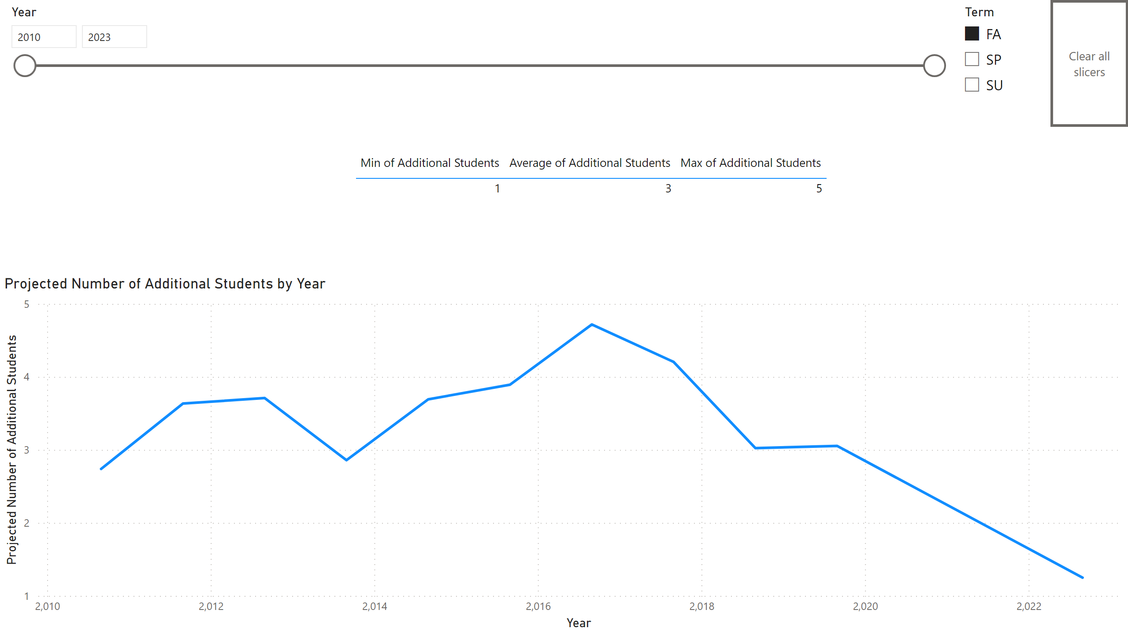
Campus Impact on EWC
Notes:
actionButton
No alt text provided
tableEx
No alt text provided
slicer
No alt text provided
slicer
No alt text provided
lineChart
No alt text provided

